Slide 1


Slide 2
Entrepreneurship and role in economic development,
Group no.1
Muhammad Zohaib
Rana Naveed
Qamar Ali
Hassan Nawaz
Qamar Husnain

Slide 3
Entrepreneurship.
entrepreneurship plays an influential role in the economic growth and standard of living of the country. As a startup founder or small business owner, you may think that you are simply working hard to build your own business and provide for yourself and your family. But you are actually doing a whole lot more for your local community, state, region, and the country as a whole.

Slide 4
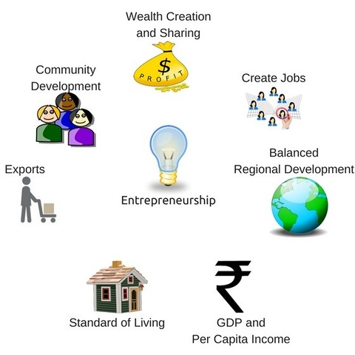
7 important roles an entrepreneur plays in the economic development of a country.

Slide 5
. Wealth Creation and Sharing
By establishing the business entity, entrepreneurs invest their own resources and attract capital (in the form of debt, equity, etc.) from investors, lenders and the public. This mobilizes public wealth and allows people to benefit from the success of entrepreneurs and growing businesses. This kind of pooled capital that results in wealth creation and distribution is one of the basic imperatives and goals of economic

Slide 6
. 2 Create Jobs:
Entrepreneurs are by nature and definition job creators, as opposed to job seekers. The simple translation is that when you become an entrepreneur, there is one less job seeker in the economy, and then you provide employment for multiple other job seekers. This kind of job creation by new and existing businesses is again is one of the basic goals of economic development. This is why the Govt. of India has launched initiatives such as StartupIndia to promote and support new startups, and also others like the Make in India initiative to attract foreign companies and their FDI into the Indian economy. All this in turn creates a lot of job opportunities, and is helping in augmenting our standards to a global level.

Slide 7
3 Balanced Regional Development
ntrepreneurs setting up new businesses and industrial units help with regional development by locating in less developed and backward areas. The growth of industries and business in these areas leads to infrastructure improvements like better roads and rail links, airports, stable electricity and water supply, schools, hospitals, shopping malls and other public and private services that would not otherwise be available.

Slide 8
4 GDP and Per Capita Income:
India’s MSME sector, comprised of 36 million units that provide employment for more than 80 million people, now accounts for over 37% of the country’s GDP. Each new addition to these 36 million units makes use of even more resources like land, labor and capital to develop products and services that add to the national income, national product and per capita income of the country. This growth in GDP and per capita income is again one of the essential goals of economic development.

Slide 9
5 Standard of Living
Increase in the standard of living of people in a community is yet another key goal of economic development. Entrepreneurs again play a key role in increasing the standard of living in a community. They do this not just by creating jobs, but also by developing and adopting innovations that lead to improvements in the quality of life of their employees, customers, and other stakeholders in the community. For example, automation that reduces production costs and enables faster production will make a business unit more productive, while also providing its customers with the same goods at lower prices.

Slide 10
6 Exports:
Any growing business will eventually want to get started with exports to expand their business to foreign markets. This is an important ingredient of economic development since it provides access to bigger markets, and leads to currency inflows and access to the latest cutting-edge technologies and processes being used in more developed foreign markets. Another key benefit is that this expansion that leads to more stable business revenue during economic downturns in the local economy.

Slide 11
7 Community Development
economic development doesn’t always translate into community development. Community development requires infrastructure for education and training, healthcare, and other public services.
A good example of how this kind of community development can be promoted is Azim Hashim Premji, Chairman of Wipro Limited, who donated Rs. 27,514 crores for promoting education through the Azim Premji Foundation. This foundation works with more than 350,000 schools in eight states across India

Slide 12


Slide 13


